Slide 1
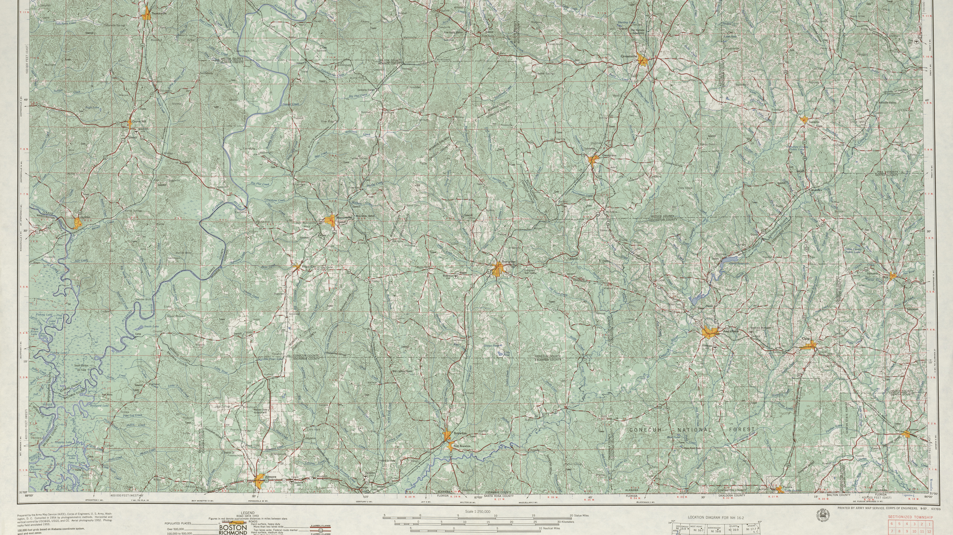




Introduction to Google Earth Engine
Asya Rahlin – Illinois Natural History Survey, University of Illinois at Urbana-Champaign
MEEC conference 4/27/2025

Slide 2
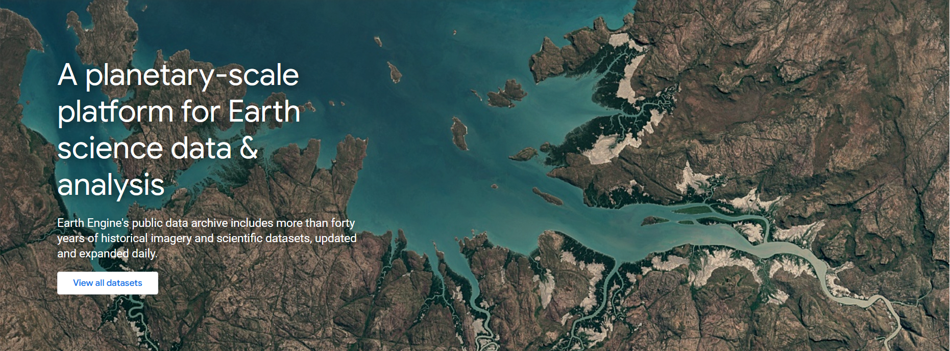
What can Google Earth Engine do?
Gorelick et al., 2017. Google Earth Engine: planetary-scale geospatial analysis for everyone. Remote Sensing of the Environment 202:18-27

Slide 3

What can Google Earth Engine do?
The Upsides
Parallel computation, it's pretty fast
Easily store and share code
Enormous data catalog
It's free!
Very good support & tutorials
Any results can be downloaded and used in your favorite GIS program
Notes:
It can be used to study: "deforestation, drought, disaster, disease, food security, water management, climate monitoring and environmental protection. It is unique in the field as an integrated platform designed to empower not only traditional remote sensing scientists, but also a much wider audience that lacks the technical capacity needed to utilize traditional supercomputers or large-scale commodity cloud computing resources."

Slide 4

What can’t Google Earth Engine do?
The Downsides
Can't escape the problem of storage - when conducting a global analysis, GEE will be slow and your resulting files will be large
Need to learn Javascript or Python
Can't run one chunk of code
There's no soft wrap
Notes:
It can be used to study: "deforestation, drought, disaster, disease, food security, water management, climate monitoring and environmental protection. It is unique in the field as an integrated platform designed to empower not only traditional remote sensing scientists, but also a much wider audience that lacks the technical capacity needed to utilize traditional supercomputers or large-scale commodity cloud computing resources."

Slide 5
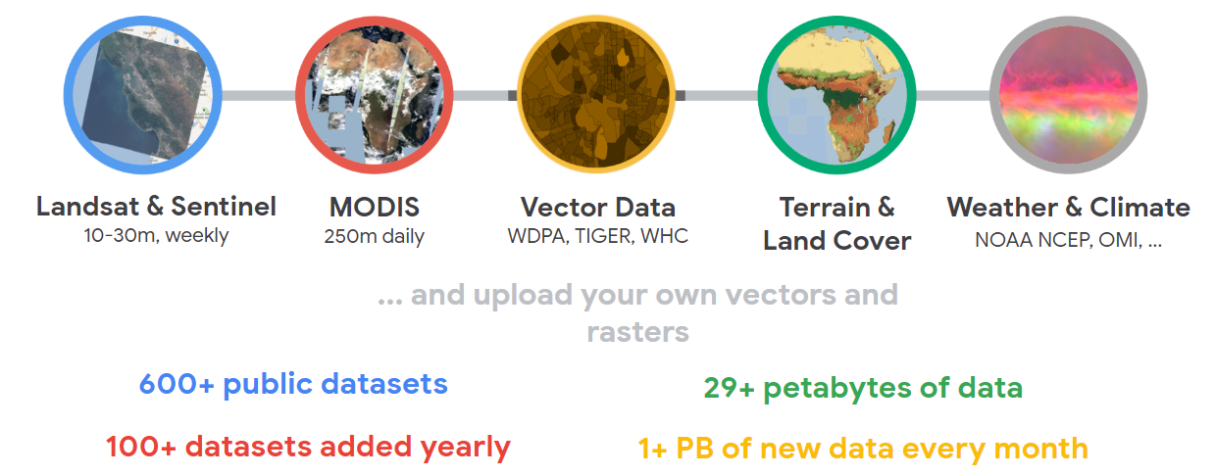
The Earth Engine Catalog
Notes:
2023 Earth Engine catalog

Slide 6
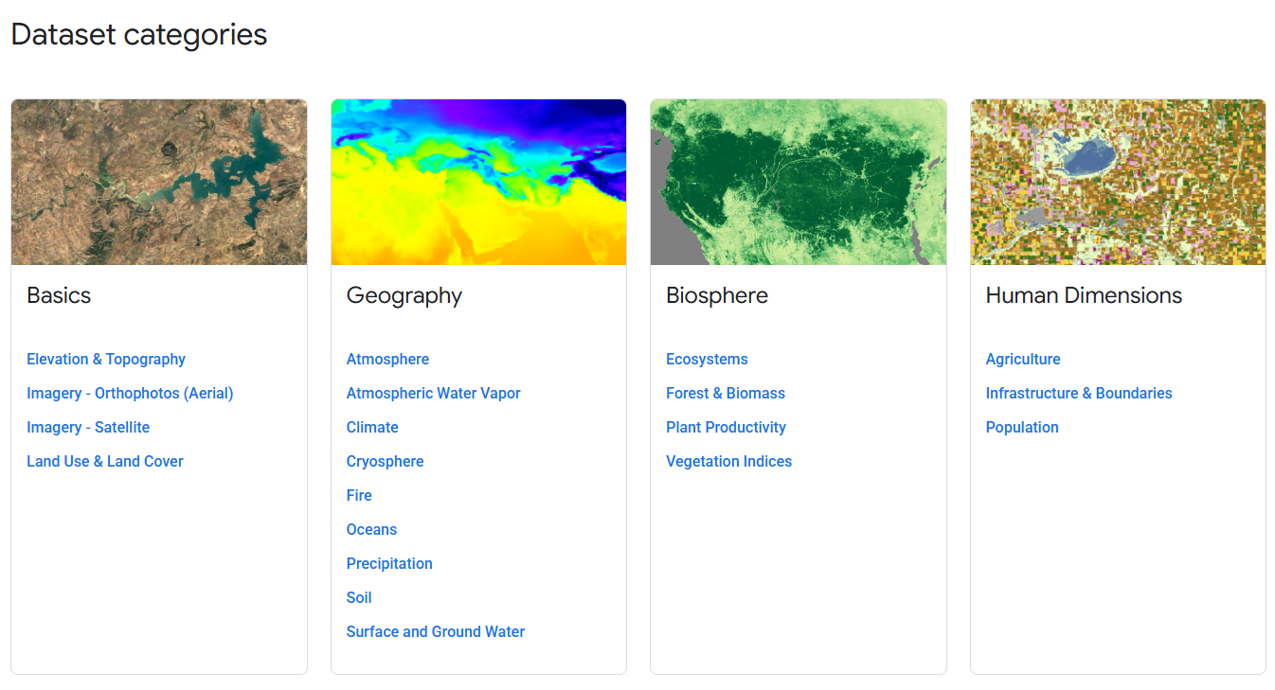
Notes:
2023 Earth Engine catalog

Slide 7
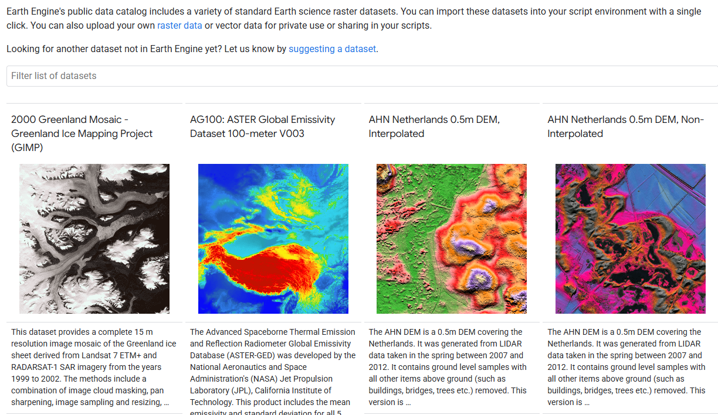
Notes:
2023 Earth Engine catalog

Slide 8
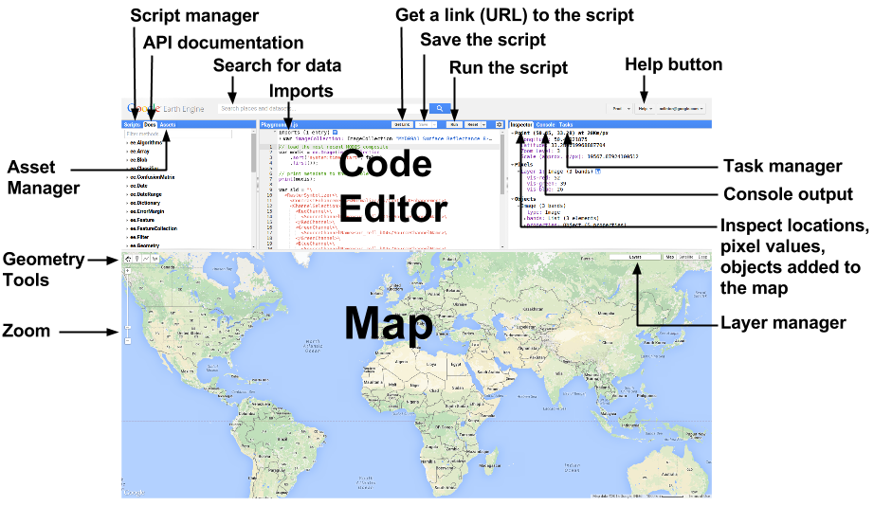
Coding in Google Earth Engine

Slide 9

Pair Programming
Two heads are often better than one
One person writes the code, the other person catches mistakes and suggests improvements
Great for brainstorming solutions!

Slide 10

Sticky Note System
Yellow sticky note = “I’m done with this section!”
Other sticky note = “I need some help!”

Slide 11


